Slide 1


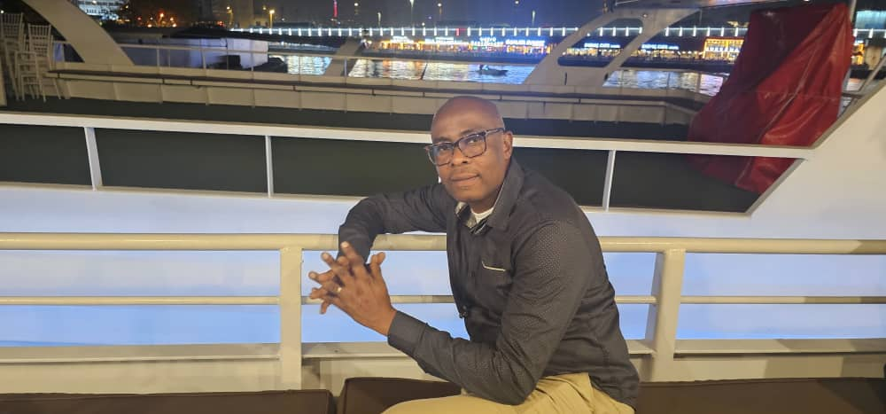
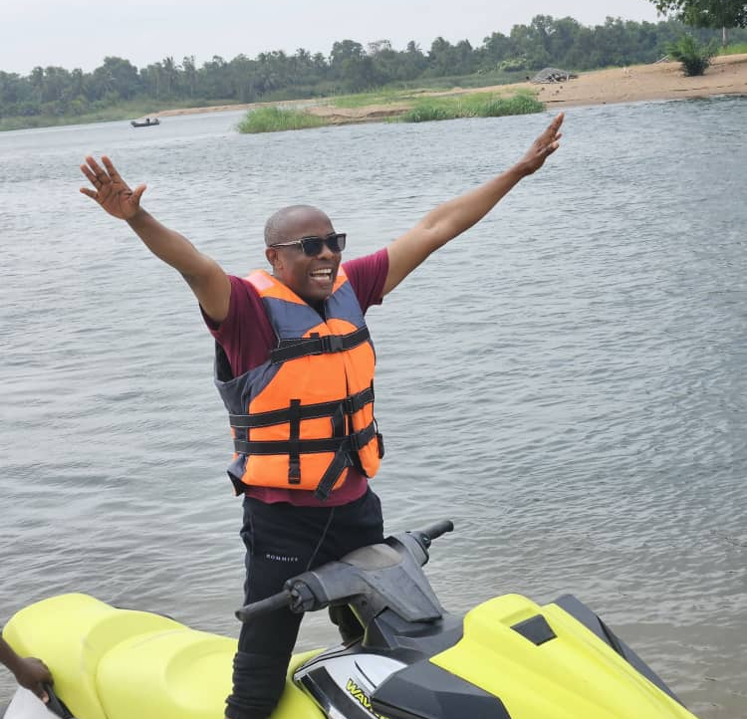
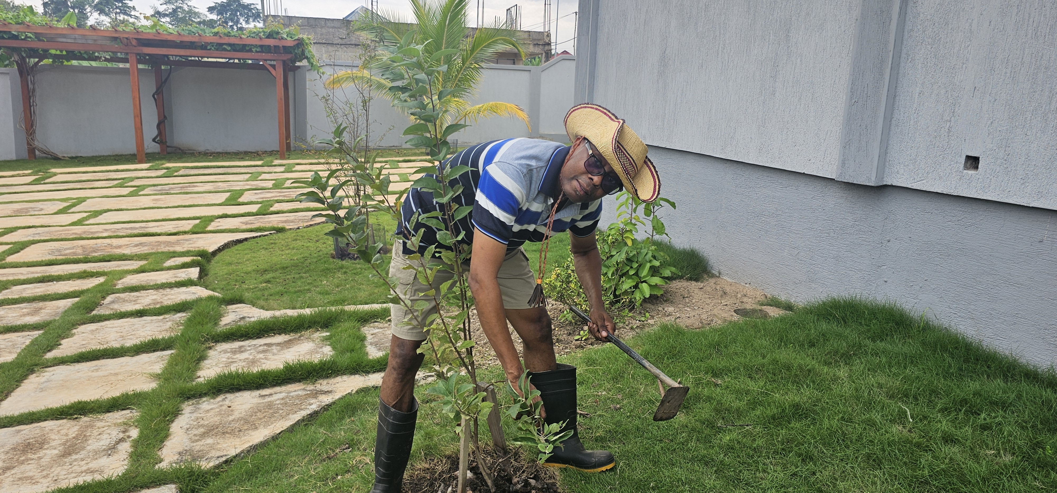
Getting to Know Me
Work
Personal
My role
Country Safety Manager
Significant others / family members / furry friends in my life
My wife, children and parents
Tenure in ofi/Olam
17.5 years
How I enjoy spending my free time
Family / Gardening / Outdoor sports
Previous companies I have worked at
Blue Skies Gh Ltd / ADM cocoa Ltd / Afrotropic cocoa
My favorite / comfort food
Native food – Eworkple / okro stew with dry fish
Why I joined ofi/Olam and what keeps me here?
I joined because, its safety and health values align with my deep-rooted passion to workplace safety.
I remained to lead impactful safety initiatives to improve lives and productivity
My favorite song
The Gambler – Kenny Rogers
Thompson Anagbonu
Thompson
Fun Facts
# Love to explore new places of historical value
# Habit of turning everyday safety activities into teachable safety moment
This is me outside work, doing stuff I enjoy in my life …

